Slide 1
Entity Frame work
By-
Chitti Dilleswari
Ayesha Mallika

Slide 2
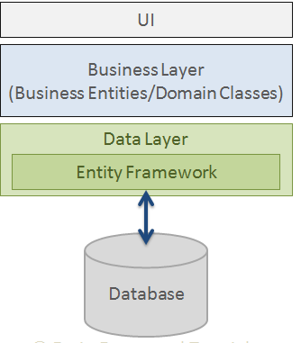
What is Entity Framework
Entity Framework fits between the business entities (Domain Classes) and the database.
It saves the data in the business properties entities and also retrieves the data from the database and converts it into the business entity's object automatically.

Slide 3
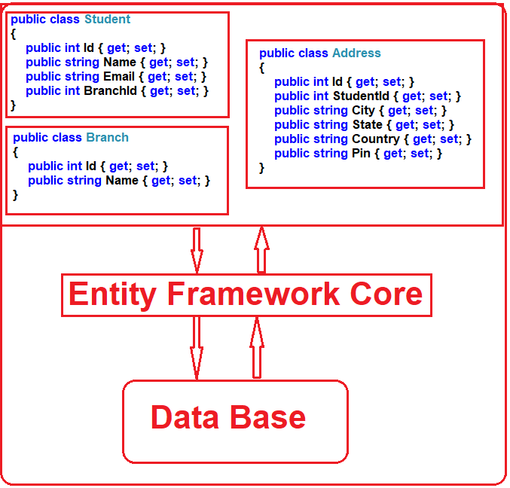
What is ORM and it’s need

Slide 4
Features of entity frame work
Modelling
Querying
EF core
Savings
Configuration
Migration

Slide 5
Code First Approach
Entity Framework
User Interface
Conceptual Model
Data Base
App Logic
Track changes
Query
Business Objects
Updates to DB

Slide 6
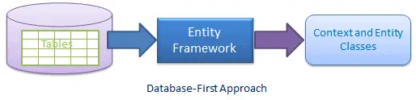
Data Base First Approach
The Entity Framework Core (EF Core) Database First approach is a technique where we start with an existing database and use EF Core to create the data access layer of our application.
This approach is useful when working with a pre-existing database .

Slide 7
Thank you

